Slide 1
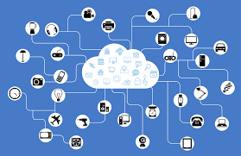
Unit 2
Organization and primary components of IoT systems

Slide 2
Contents
Structure of IoT systems
IoT backend modules
IoT gateways
IoT edge

Slide 3
IoT Architecture Key Components

Slide 4
Physical Design of IoT
The "Things" in IoT usually refers to IoT devices which have unique identities and can perform remote sensing, actuating and monitoring capabilities.
IoT devices can:
Exchange data with other connected devices and applications (directly or indirectly), or
Collect data from other devices and process the data locally or
Send the data to centralized servers or cloud-based application back-ends for processing the data, or
Perform some tasks locally and other tasks within the IoT infrastructure, based on temporal and space constraints

Slide 5
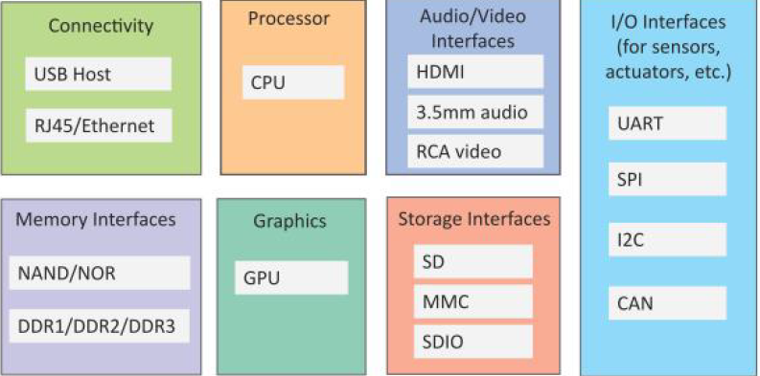
Generic block diagram of an IoT Device
An IoT device may consist of several interfaces for connections to other devices, both wired and wireless.
I/O interfaces for sensors
Interfaces for Internet connectivity
Memory and storage interfaces
Audio/video interfaces.

Slide 6
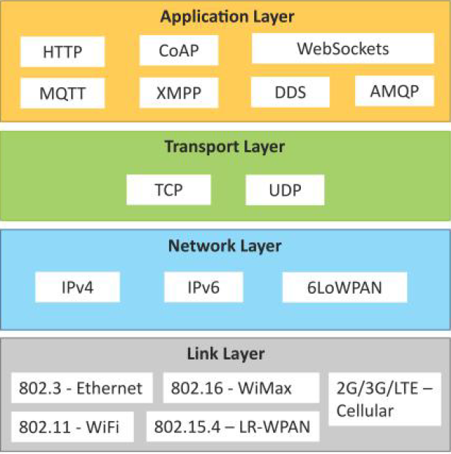
IoT Protocols

Slide 7
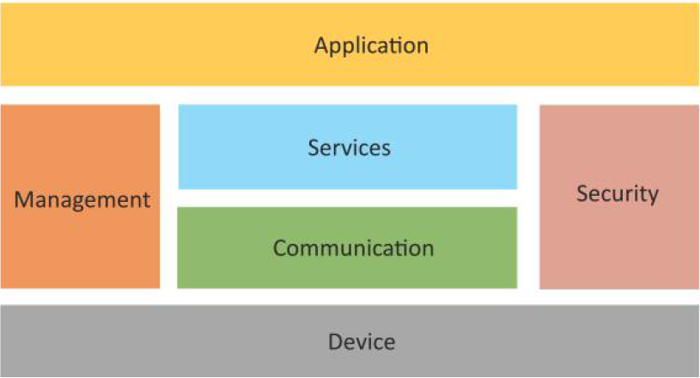
Logical Design of IoT
Logical design of an IoT system refers to an abstract representation of the entities and processes without going into the low-level specifics of the implementation.
An IoT system comprises of a number of functional blocks that provide the system the capabilities for identification, sensing, actuation, communication, and management.

Slide 8
Communication models in IoT
Request-Response communication model
Publish-Subscribe communication model
Push-Pull communication model
Exclusive Pair communication model

Slide 9
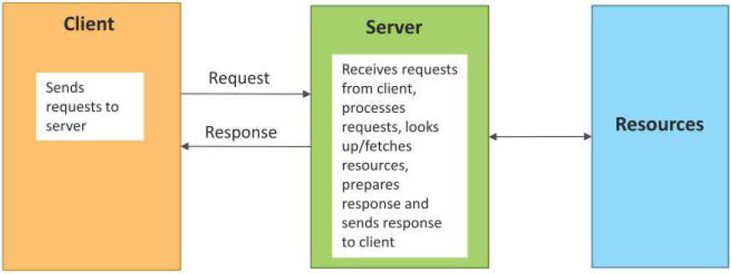
Request-Response communication model
Request-Response is a communication model in which the client sends requests to the server and the server responds to the requests.
When the server receives a request, it decides how to respond, fetches the data, retrieves resource representations, prepares the response, and then sends the response to the client.

Slide 10
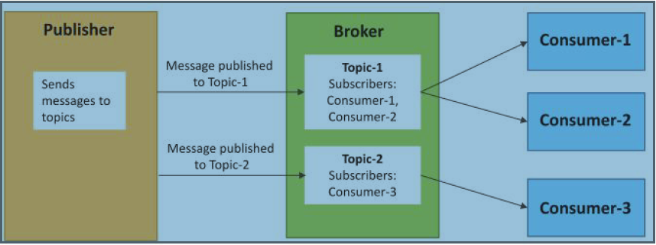
Publish-Subscribe communication model
Publish-Subscribe is a communication model that involves publishers, brokers and consumers.
Publishers are the source of data. Publishers send the data to the topics which are managed by the broker. Publishers are not aware of the consumers.
Consumers subscribe to the topics which are managed by the broker.
When the broker receives data for a topic from the publisher, it sends the data to all the subscribed consumers.

Slide 11
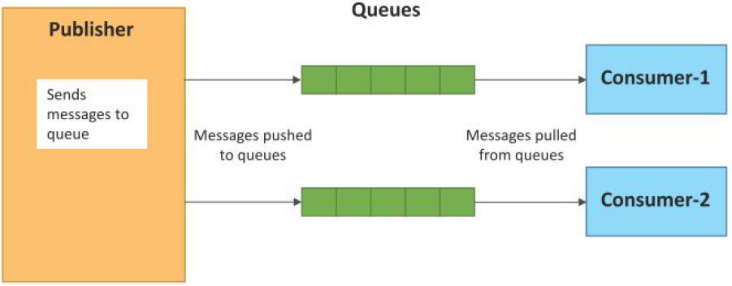
Push-Pull communication model
Push-Pull is a communication model in which the data producers push the data to queues and the consumers pull the data from the queues.
Producers do not need to be aware of the consumers.
Queues help in decoupling the messaging between the producers and consumers.
Queues also act as a buffer which helps in situations when there is a mismatch between the rate at which the producers push data and the rate at which the consumers pull data.

Slide 12
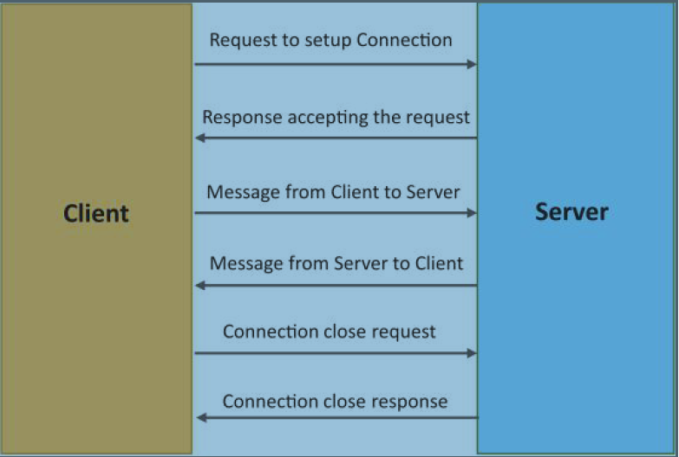
Exclusive Pair communication model
Exclusive Pair is a bidirectional, fully duplex communication model that uses a persistent connection between the client and server.
Once the connection is setup it remains open until the client sends a request to close the connection.
Client and server can send messages to each other after connection setup.

Slide 13
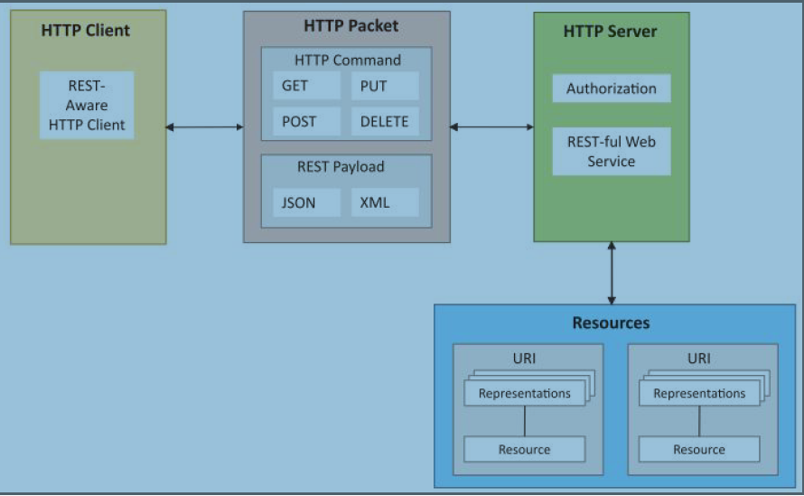
Communication API’s
REST-based Communication APIs
Representational State Transfer (REST) is a set of architectural principles by which you can design web services and web APIs that focus on a system’s resources and how resource states are addressed and transferred.
REST APIs follow the request response communication model.
The REST architectural constraints apply to the components, connectors, and data elements, within a distributed hypermedia system.

Slide 14
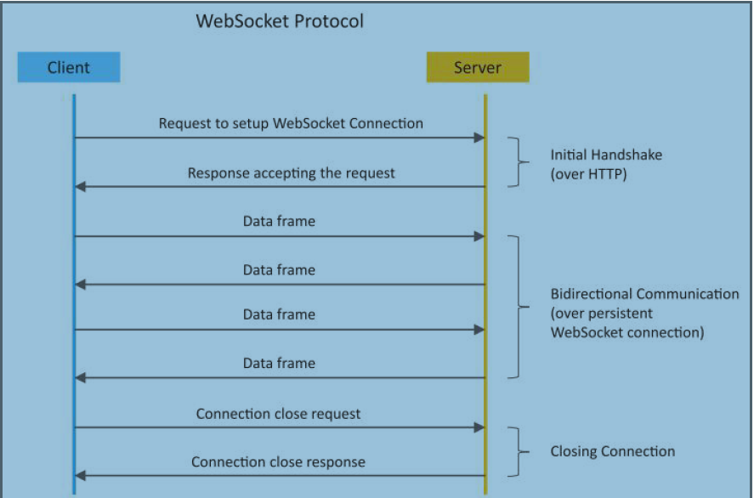
Communication API’s
WebSocket-based Communication APIs
WebSocket APIs allow bidirectional, full duplex communication between clients and servers.
WebSocket APIs follow the exclusive pair communication model

Slide 15

Structure of IoT systems
Device
Resource
Controller Service
Database
Web service
Analysis Component
Application
Analysis
Application
Web Service
Database
Controller Service
Resource
Device

Slide 16
Structure of IoT
An IoT system comprises of the following components:
• Device: An IoT device allows identification, remote sensing, actuating and remote monitoring capabilities.
• Resource: Resources are software components on the IoT device for accessing, processing, and storing sensor information, or controlling actuators connected to the device. Resources also include the software components that enable network access for the device.
•Controller Service: Controller service is a native service that runs on the device and interacts with the web services. Controller service sends data from the device to the web service and receives commands from the application (via web services) for controlling the device.

Slide 17
Structure of IoT
Database: Database can be either local or in the cloud and stores the data generated by the IoT device.
Web Service: Web services serve as a link between the IoT device, application, database and analysis components. Web service can be either implemented using HTTP and REST principles (REST service) or using WebSocket protocol (WebSocket service).
Analysis Component: The Analysis Component is responsible for analyzing the IoT data and generate results in a form which are easy for the user to understand.
Application: IoT applications provide an interface that the users can use to control and monitor various aspects of the IoT system. Applications also allow users to view the system status and view the processed data.

Slide 18
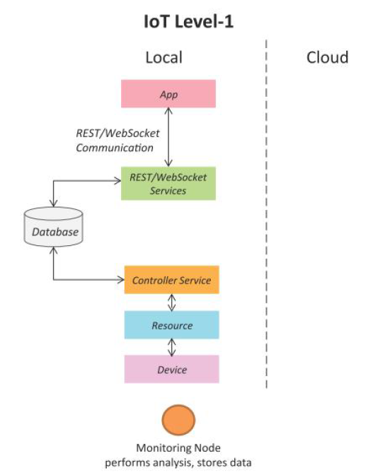
IoT Levels & Deployment Templates
IoT Level-1
It has a single node/device that performs sensing and/or actuation, stores data, performs analysis and hosts the application
suitable for modeling low-cost and low-complexity solutions where the data involved is not big and the analysis requirements are not computationally intensive.

Slide 19
IoT Level-1 example
This level consists of air conditioner, temperature sensor, data collection and analysis and control & monitoring app. • The data sensed in stored locally. • The data analysis is done locally. • Monitoring & Control is done using Mobile app or web app. • The data generated in this level application is not huge. • All the control actions are performed through internet.
• Example: Room temperature is monitored using temperature sensor and data is stored/analysed locally. Based on analysis made, control action is triggered using mobile app or it can just help in status monitoring.

Slide 20
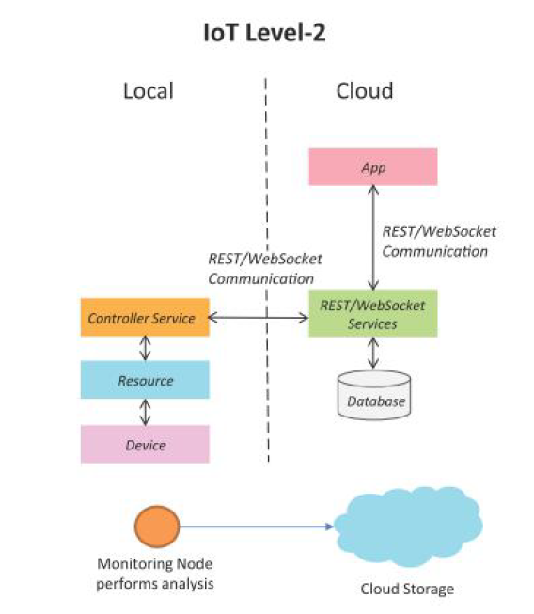
IoT Level-2
A level-2 IoT system has a single node that performs sensing and/or actuation and local analysis.
Data is stored in the cloud and application is usually cloud based.
Level-2 IoT systems are suitable for solutions where the data involved is big, however, the primary analysis requirement is not computationally intensive and can be done locally itself.

Slide 21
IoT Level-2 example
This level consists of air conditioner, temperature sensor, Big data (Bigger than level -1, data analysis done here) , cloud and control & monitoring app. • This level-2 is complex compare to level-1. Moreover rate of sensing is faster compare to level-1. • This level has voluminous size of data. Hence cloud storage is used. • Data analysis is carried out locally. Cloud is used for only storage purpose. • Based on data analysis, control action is triggered using web app or mobile app.
• Examples: Agriculture applications, room freshening solutions based on odour sensors etc.

Slide 22
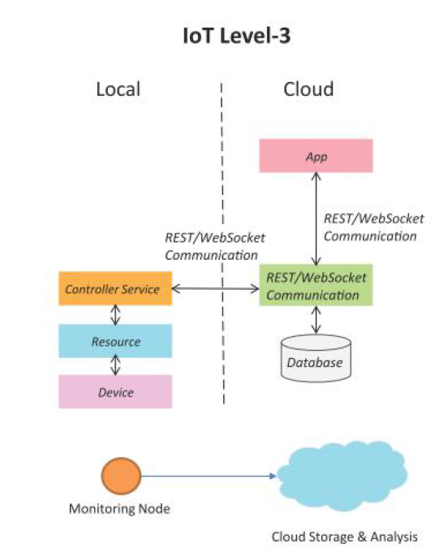
IoT Level-3
A level-3 IoT system has a single node. Data is stored and analyzed in the cloud and application is cloud based.
Level-3 IoT systems are suitable for solutions where the data involved is big and the analysis requirements are computationally intensive.

Slide 23
IoT Level-3 example
This level consists of air conditioner, temperature sensor, big data collection (Bigger than level-1) , cloud (for data analysis) and control & monitoring app. • Data here is voluminous i.e. big data. Frequency of data sensing is fast and collected sensed data is stored on cloud as it is big. • Data analysis is done on the cloud side and based on analysis control action is triggered using mobile app or web app.
• Examples: Agriculture applications, room freshening solutions based on odour sensors etc.

Slide 24
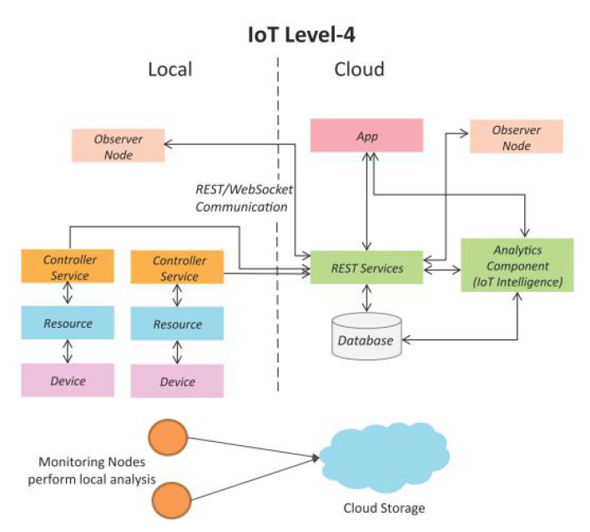
IoT Level-4
A level-4 IoT system has multiple nodes that perform local analysis. Data is stored in the cloud and application is cloud-based.
Level-4 contains local and cloud based observer nodes which can subscribe to and receive information collected in the cloud from IoT devices.
Level-4 IoT systems are suitable for solutions where multiple nodes are required, the data involved is big and the analysis requirements are computationally intensive.

Slide 25
IoT Level-4 example
This level consists of multiple sensors, data collection and analysis and control & monitoring app. • At this level-4, multiple sensors are used which are independent of the others. • The data collected using these sensors are uploaded to the cloud separately. The cloud storage is used in this level due to requirement of huge data storage. • The data analysis is performed on the cloud and based on which control action is triggered either using web app or mobile app.

Slide 26
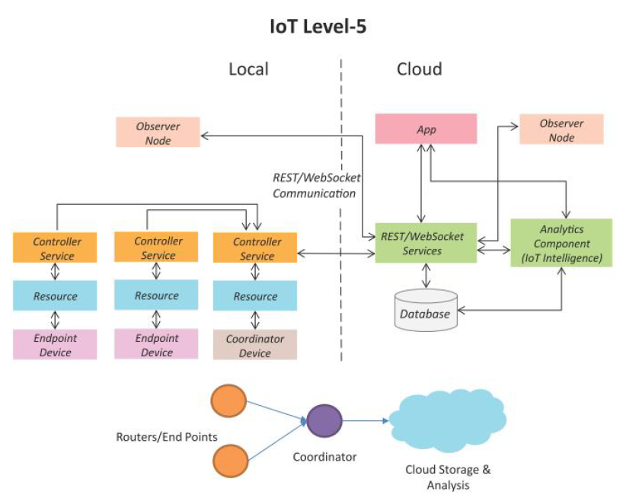
IoT Level-5
A level-5 IoT system has multiple end nodes and one coordinator node.
The end nodes that perform sensing and/or actuation.
Coordinator node collects data from the end nodes and sends to the cloud.
Data is stored and analyzed in the cloud and application is cloud-based.
Level-5 IoT systems are suitable for solutions based on wireless sensor networks, in which the data involved is big and the analysis requirements are computationally intensive.

Slide 27
IoT Level-5 example
This level consists of multiple sensors, coordinator node, data collection and analysis and control & monitoring app. • This level is similar to level-4 which also has huge data and hence they are sensed using multiple sensors at much faster rate and simultaneously. • The data collection and data analysis is performed at the cloud level. • Based on analysis, control action is performed using mobile app or web app.

Slide 28
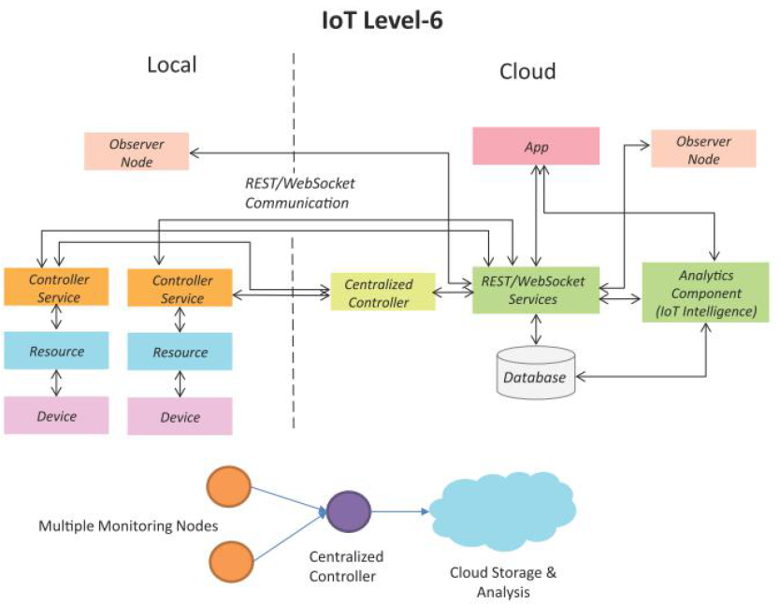
IoT Level-6
A level-6 IoT system has multiple independent end nodes that perform sensing and/or actuation and send data to the cloud.
Data is stored in the cloud and application is cloud-based.
The analytics component analyzes the data and stores the results in the cloud database.
The results are visualized with the cloud-based application.
The centralized controller is aware of the status of all the end nodes and sends control commands to the nodes.

Slide 29
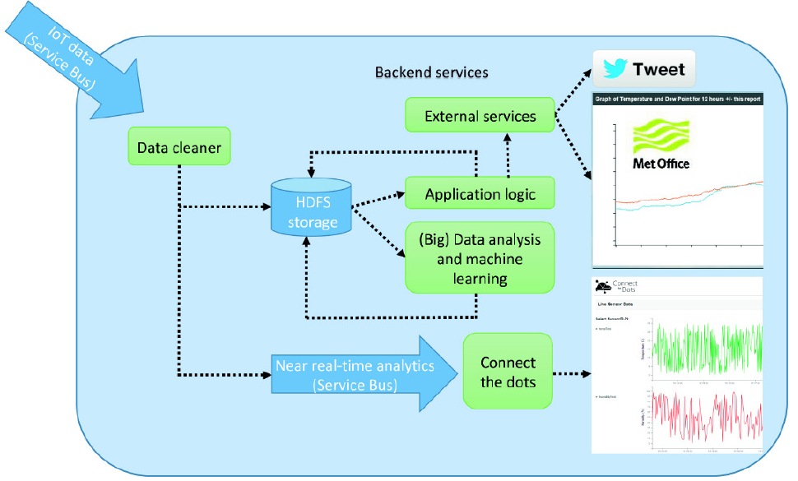
IoT backend modules
The backend services are predominantly
--- used to store the IoT device data
but can include additional functionality such as
---individual device configuration and
analysis algorithms.
IoT backend service will need to be able to scale and maintain a high level of availability.
To cloud/not to cloud?
File System?
Example: Backend Processing for the Weather Station SHT15 Sensor, Showing a Variety of Services Supported

Slide 30
IoT gateways
Every IoT system needs some way to connect sensors/devices to the cloud so that data can be sent back-and-forth between them.
IoT gateways can be essential in making this connection possible because gateways act as bridges between sensors/devices and the cloud.
Many sensors/devices will “talk” to a gateway and the gateway will then take all that information and “talk” to the cloud.

Slide 31
IoT gateways benefits
Battery life: Gateways allow sensors/devices to communicate over shorter distances, boosting battery life.
Varying protocols :Gateways can communicate with sensors/devices over varying connectivity types and then translate that data into a standard protocol such as MQTT to be sent to the cloud.
Unfiltered data: Gateways can pre-process and filter the data being generated by sensors/devices to decrease transmission, processing, and storage requirements.
High latency: Gateways can reduce latency in time-critical applications by performing processing on the gateway itself rather than in the cloud.
Security: Gateways reduce the number of sensors/devices connected to the internet because the sensors/devices are only connected to the gateway. However, this makes gateways themselves targets and also the first line of defense. This is why security needs to be a priority for any gateway.

Slide 32
IoT edge
IoT Edge is an Internet of Things (IoT) service that builds on top of the IoT Hub and enables users to carry out edge computing.
Edge computing is when data is analyzed on devices, that is, at the edge of the network, rather than in the cloud itself.
With edge computing, you can avoid transferring raw data by carrying out data cleaning, aggregation, and analysis on the device itself, and then send the insights gained to the cloud.
This will result in reduced bandwidth costs, quicker response times and reduced traffic.

Slide 33
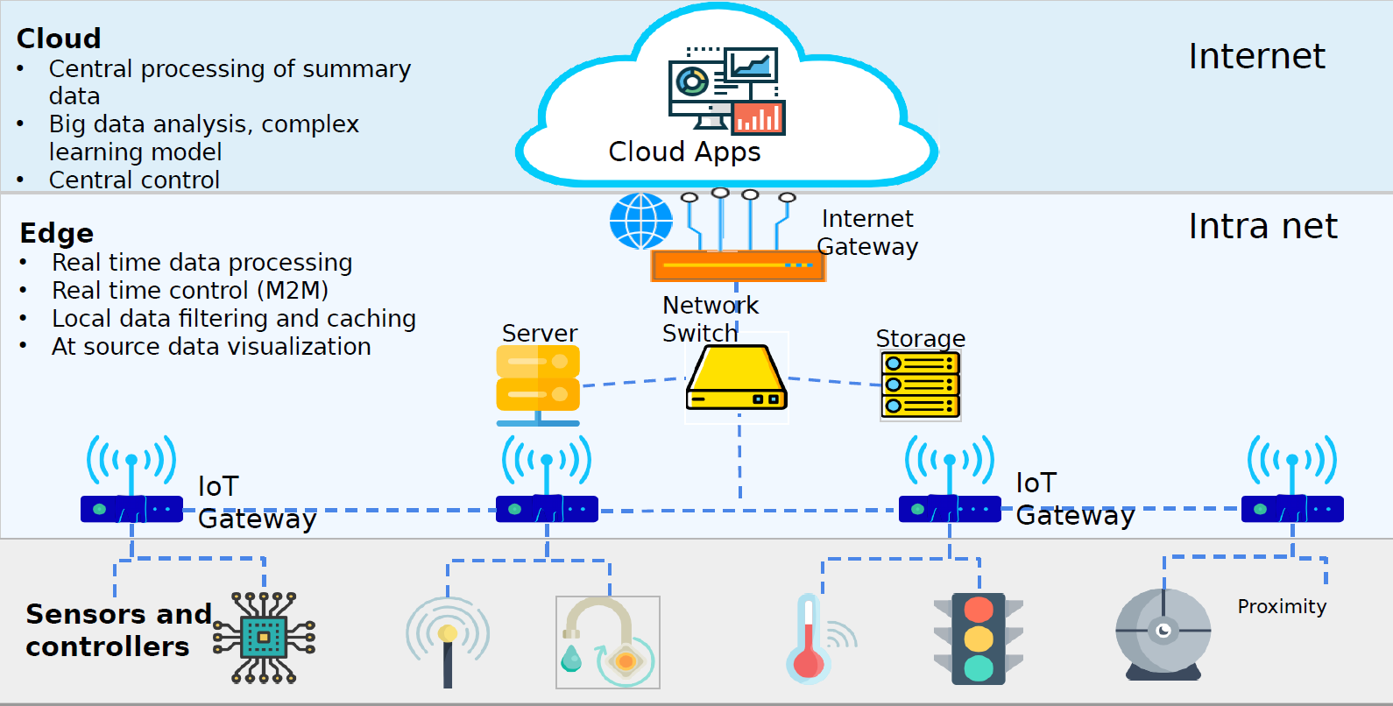
Edge Computing

Slide 34
Edge Computing Characteristics
Geographically distributed
Scalable
Autonomous and distributed
Edge computing is contextual and low latency
Real-time interactions
Heterogeneous

Slide 35
Benefits of Edge Computing
Faster Response
Operating at the source of data
Faster response time for triggers
Secure
Locally stored
No theft during transport
Compliance maintained
Reliable Operations
Can work without connectivity.
Cost Effective
No need to transport everything to cloud
No recurring cost

Slide 36
Applications of Edge Computing
Applications That Require Autonomy
Self-driving cars
Applications That Can’t Tolerate Latency
Health Care services
Applications that need significant bandwidth
Video streaming

Slide 37
Artificial Intelligence on the edge
Azure also offers services such as Azure Functions, Azure Stream Analytics and Azure Machine Learning which can all be run via Azure IoT Edge.
This means that you can deploy AI, including image recognition, machine learning and complex event processing without having to write the code in-house.
Azure IoT Edge's components:
IoT Edge modules
The IoT Edge runtime
A cloud-based interface.

Slide 38
IoT Edge modules
These are containers that run Azure services, 3rd party services, or your own code.
IoT Edge modules are deployed and execute locally on IoT Edge devices. Multiple modules can be configured to communicate with each other.
You can also package Azure services into modules or develop custom modules. If you want to deploy your own code to your devices, Azure IoT Edge supports both Linux and Windows and Java, .NET Core 2.0, Node.js, C, and Python.

Slide 39
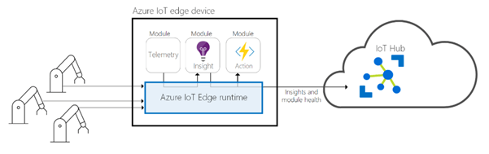
The IoT Edge runtime
This runs on each IoT Edge device and manages the modules deployed there.
It performs a number of functions including monitoring and managing the device and facilitating communications between the modules, the device, other devices, and the cloud.
The runtime supports both Linux and Windows operating systems.

Slide 40
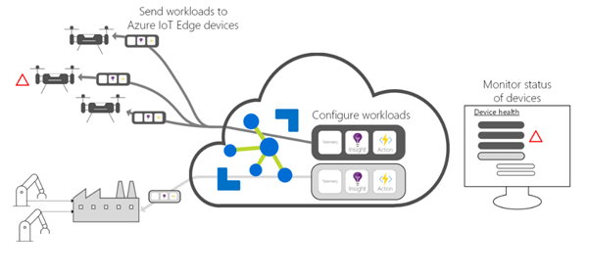
Cloud-based interface
This interface allows you to remotely monitor and manage IoT Edge devices.
Cloud services allow users to create and configure a workload to be run on a specific type of device, send a workload to a set of devices and monitor workloads running on devices in the field.

Slide 41
Using an IoT edge device as a gateway
There are three patterns for using an IoT Edge device as a gateway:
transparent
protocol translation
identity translation

Slide 42
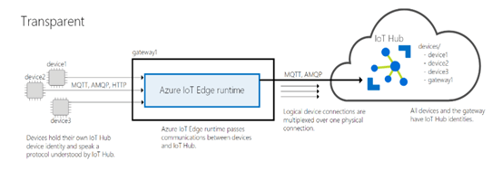
Transparent
Devices are connected to a gateway device instead of IoT Hub.
The gateway passes communications between the devices and IoT Hub.
Both the devices themselves and a user interacting with the devices do not know that they are communicating with the cloud via a gateway.

Slide 43
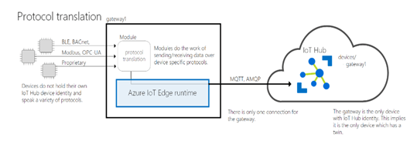
Protocol translation
If a device doesn't support MQTT, AMQP, or HTTP, then it uses a gateway device to send data to IoT Hub.
All the information will look like it's coming from one device, the gateway device.
If cloud applications want to analyze the data on a per device basis, then additional identifying information must be embedded in their messages...

Slide 44
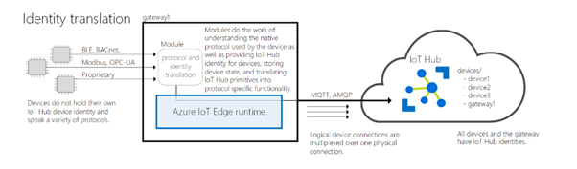
Identity translation
If a device cannot connect to the IoT Hub, then it connects to a gateway device instead.
The gateway is able to understand the protocols used by downstream devices and provide the identity.

Slide 45
References
https://www.iotforall.com/what-is-a-gateway/
Adrian McEwen and Hakim Cassimally. 2013. Designing the Internet of Things (1st. ed.). Wiley Publishing.
https://www.slideshare.net/chetansk/edge-computing-109820603?qid=4b1c2bc7-46b5-4d29-b2fe-5b431903277e&v=&b=&from_search=1
https://www.codeproject.com/Articles/1261285/What-is-IoT-Edge

